Slide 1
Youtube Trending Statistics
Done By:
Ashish Ramayee Asokan (PES1201801573)
K Nidarshan (PES1201800244)
Arkaprovo Ghosh (PES1201800214)

Slide 2
Agenda
Analysis of the viewership lifecycle and basic statistics of trending-video content.
Directional-Relationship analysis of trending-video viewership and the viewership of its categories.
Determining the strength of association between various factors affecting trending videos such as likes, views, dislikes and comment_count.

Slide 3
Introduction
Unlike popular videos, which would have already achieved high viewership numbers by the time they are declared popular, YouTube trending videos represent content that targets viewers’ attention over a relatively short time, and has the potential of becoming popular.
YouTube provides public statistics regarding its uploaded videos, most notably the number of views, which shows the aggregate number of times a video has been watched up to that point.
Considering the fact that more than one billion unique users visit YouTube each month and they upload 72 hours of video every minute , YouTube is the best place for e.g. brand engagement or advertising, but it is genuinely difficult and competitive to get the attention of users.

Slide 4
Motivation
Better understanding of YouTube trending videos and their statistics, and a deeper insight about their life cycles, can greatly affect the strategies for marketing, target advertising, recommendation systems and search engines.
Finding these trends are significantly important , many different websites have made efforts to pick up on the latest trends on the web, such as “buzzFeed” or “whatTheTrend”. There are other kinds of websites such as “channelFactory” that tries to build an audience on YouTube for content owners or advertisers.
Attempts toward the study of these statistics are very significant in developing an insight into the trending videos and viewership pattern among its different categories. This represents a key motivation for our effort.

Slide 5
Description
Each row contains details about a video.
The columns in the dataset are as follows :
Video_id ( String)
Trending_date (String)
Title (String)
Channel_title (String)
Category_id (ID)
Publish_time (Date)
Tags (String)
Views (Integer)
Likes (Integer)
Dislikes (Integer)
Comment_count (Integer)
Thumbnail_link (URL)
Comments_disabled (Boolean)
Ratings_disabled (Boolean)
Video_error_or_removed (Boolean)
Description (String)

Slide 6
Scope of the Project
The insights obtained from the statistical analysis of the YouTube trending data can greatly affect the strategies for marketing, target advertising, recommendation systems and search engines and can also be used to build predictive models for services with crowd based interactions.
For example, YouTube has more than a million advertisers that employ Google ad platforms, and according to YouTube stats the majority of these advertisers are small businesses. Having an insight about trending videos’ lifecycles and the viewership pattern among its popular categories can arguably be instrumental for such applications.
It provides an opportunity to study and analyze the inter-relationships among trending videos’ viewership through their recordings (time series).

Slide 7
Data Cleaning
The numerical columns ‘likes’ , ‘dislikes’, ‘views’ and ‘comment_count’ has missing values and data of type string.
The categorical columns comments_disabled , ratings_disabled and video_error_or_removed has missing values.
The string values in the numeric column were converted to a numeric value
The missing values in the numerical columns were replaced by the mean of the same column .
The missing values in the categorical column are replaced by the previous row value.

Slide 8
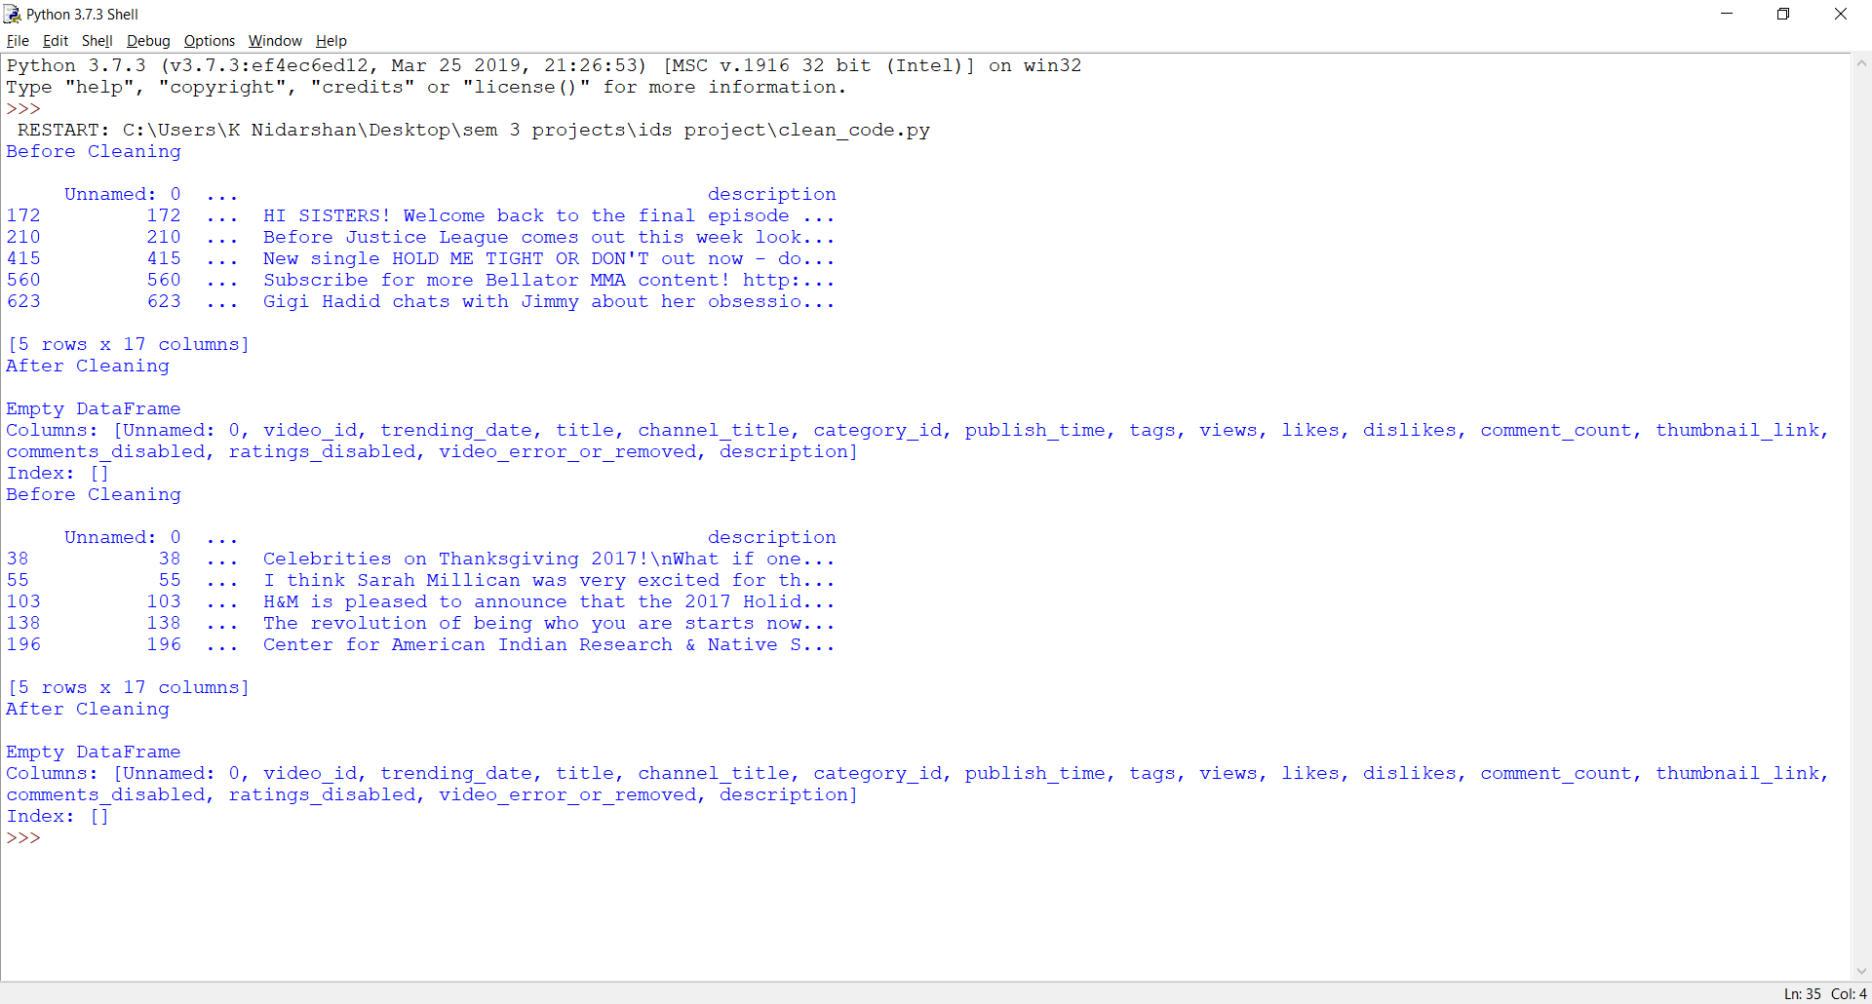
Results After Cleaning

Slide 9
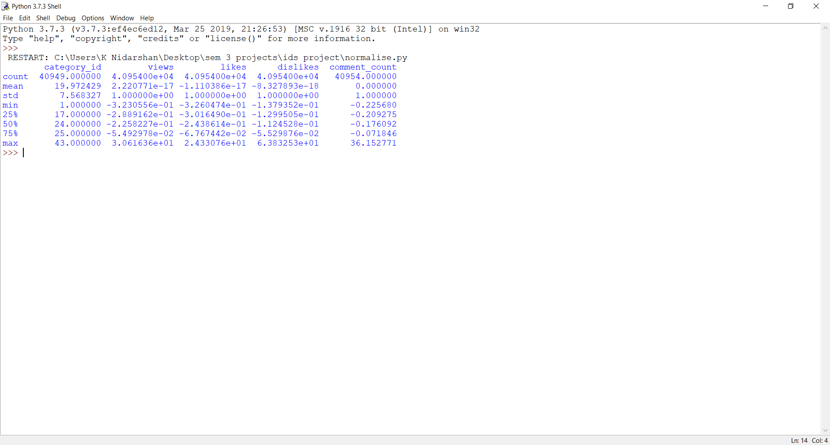
Standardization
Standardization refers to the process of centering the data around 0, i.e, altering the values of the given data such that the mean is 0 and variance is 1.
Normalization refers to altering the values in the dataset such that all entries of the numerical columns are between 0 and 1.
Standardisation is required to ensure that the data is internally consistent. Normalization is required by machine learning models when the testing and training sets have different ranges of values.

Slide 10
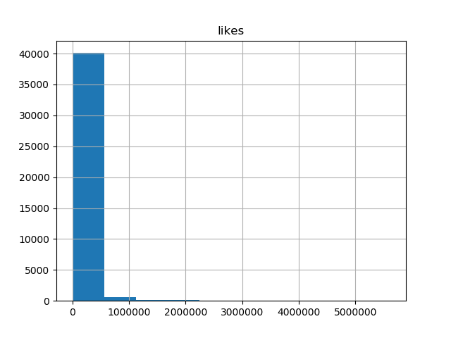
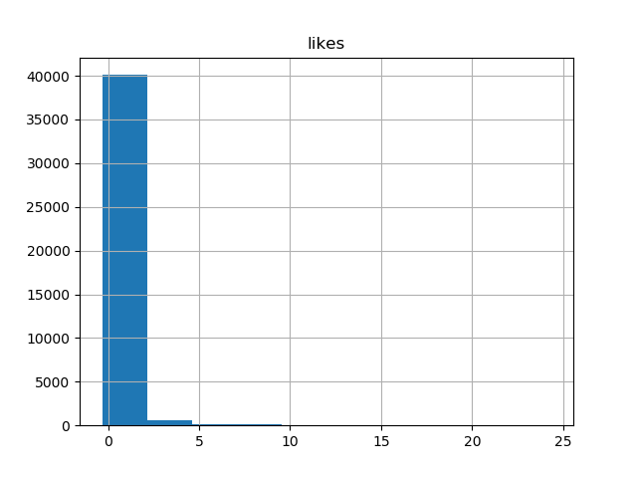
Visualization
Before Standardization :
After Standardization:

Slide 11
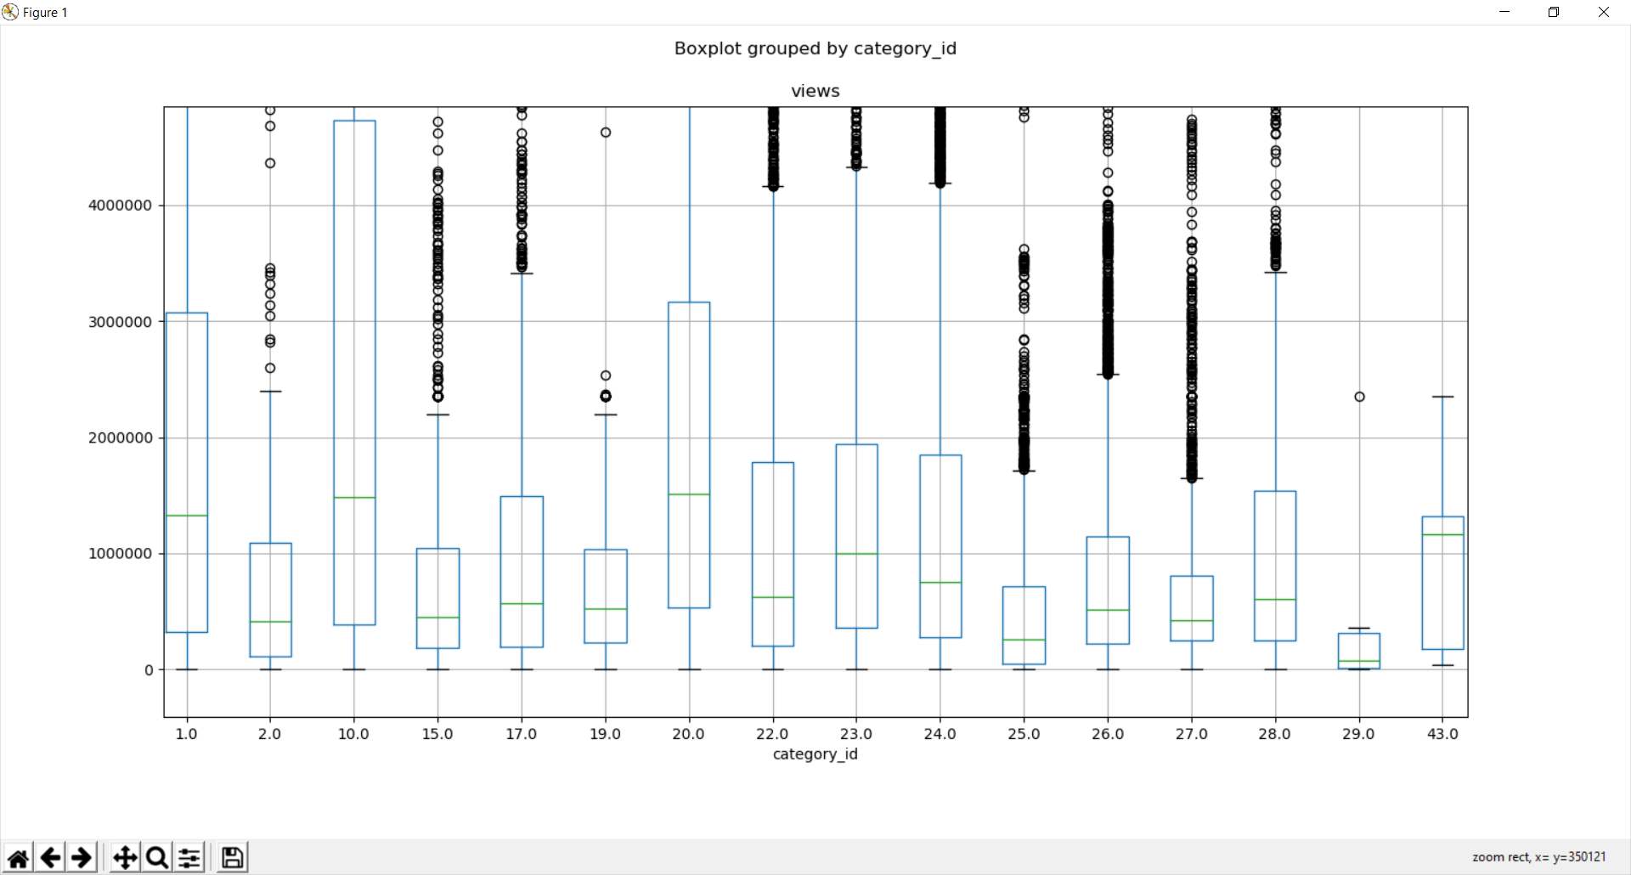
Box Plot - Column Views

Slide 12
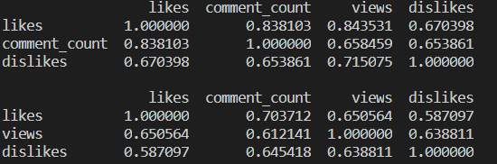
Correlation Analysis
Pearson:
Highest r = views - likes
Lowest r = dislikes - comment_count
Kendall:
Highest r = likes - comment_count
Lowest r = likes - dislikes
Correlation is a bivariate analysis that measures the strength of association between two variables and the direction of the relationship. In terms of the strength of relationship, the value of the correlation coefficient varies between +1 and -1.
A higher value of this correlation coefficient implies a stronger relation between the two given attributes. In this test, the correlation coefficients are computed for all the numerical attributes in the dataset.

Slide 13
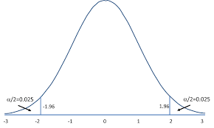

Hypothesis Testing for likes Column
x = Sample mean
s = Sample Standard Deviation
μ = Population Mean
S = Population Standard Deviation
Population Size: 41000 (approx)
Sample Size: 1000
Null Hypothesis H₀ : x’ = μ (74234.014)
Alternate Hypothesis H₁ : x’ not equal to μ

Slide 14
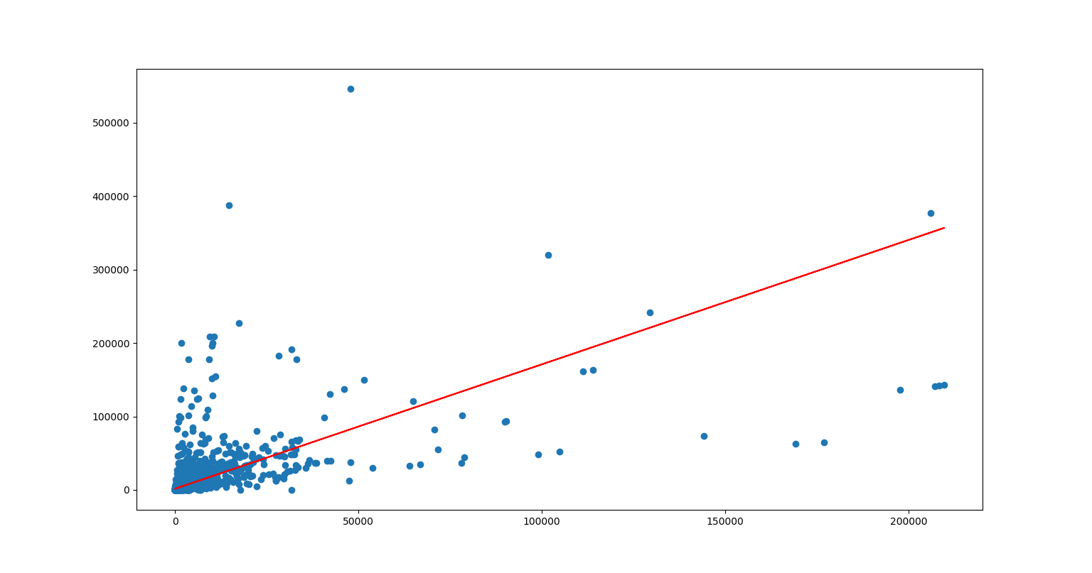
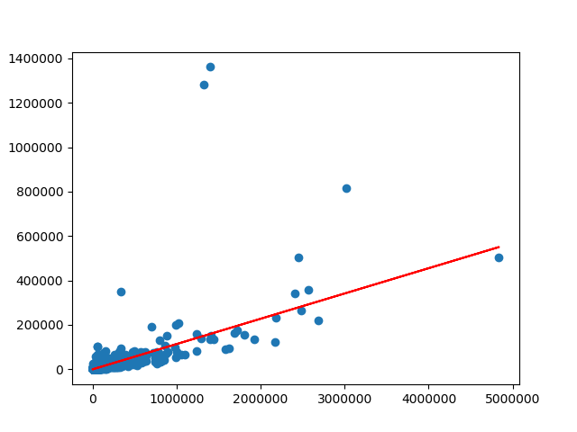
Simple Linear Regression
Least Squares line for dislikes vs comment_count
Least Squares line for likes vs comment_count
comment_count
comment_count
dislikes
likes
RMSE: 20123.232907419402
RMSE: 30506.75080681049

Slide 15
Insights
The box plot shows the existence of outliers in almost every category except category 1 , 20 and 43 .
The views in Category 10 has the greatest mean followed by category 20 . On the other hand category 29 has the least overall mean garnering less views.
Category 10 has a large number of values in the 3rd quartile . So the graph is left skewed
Histograms for the likes and comment_count attributes show that there are a very large number of values in the range of 0 - 1000000. Standardisation shifts the histogram to the left such that the distribution is centered around 0.
Simple linear regression models constructed for likes vs comment_count and dislikes vs comment_count show a large Root Mean Square Error (RMSE) due to the nature of the data used (containing a large number of outliers, non-linearity).
The correlation analysis shows highest correlation coefficient between views and likes and least correlation coefficient between dislikes and comment count.

Slide 16
Tools and Technologies
Numpy - Multi-dimensional arrays and Hypothesis testing
Matplotlib - Plotting graphs for visualisation
Pandas - Accessing dataset , data cleaning
Sklearn - Simple Linear Regression

Slide 17
References
Iman Barjasteh, Ying Liu , Hayder Radha, Trending Videos: Measurement and Analysis
www.kaggle.com

